Slide 1
SETTING UP A FILM STUDIO & GENERATING CONTENT
GROUP 6

Slide 2
Introduction
Overview
In pursuit of diversification a company intends to set up a movie studio in order to create and sell original content. It is therefore necessary for the company to undertake a pre-entry business viability assessment as an important and effective management approach in the new enterprise.

Slide 3
Background
Business understanding
In 2019 the global film industry was worth over USD 42 billion(Wikipidea) with the largest markets being the United States , Asia-pacific , the UK and Europe.
The industry comprises various film genres such as action, crime, animated, comedy, drama among others.

Slide 4
Data overview
The project uses data from the global film Industry between 2010 to 2019 mined from www.imdb.com website.
The data comprises movie basics, movie ratings, genre, runtime, directors and writers among others. The data is cleaned , analyzed and the findings used to inform decision making.

Slide 5
Description of variables
1.Genre- a style or category of a movie e.g. action, horror, comedy, drama etc.
*2.Runtime- This is the length of the movie.
*3.Ratings- ranking of the movie in the box office.
*4.Director profession-the occupation of the movie directors. *5.Ordering- The number of movies ordered.
*6.Region- The geographical area to be targeted.

Slide 6
Business Problem
The company lacks filmmaking experience and therefore necessary to undertake this project to inform the decision to open a new studio.
Therefore, the primary challenge is to overcome this lack of experience and create a successful movie studio that produces high-quality movies that appeal to a wide audience.
The management will utilize the results and findings of this analysis to guide on the content to be produced by the new studio.

Slide 7
Objectives
To explore film genres that are marketable for the company.
To determine the appropriate movie runtime.
Determine which region to target.

Slide 8
Data Analysis and Visualization

Slide 9
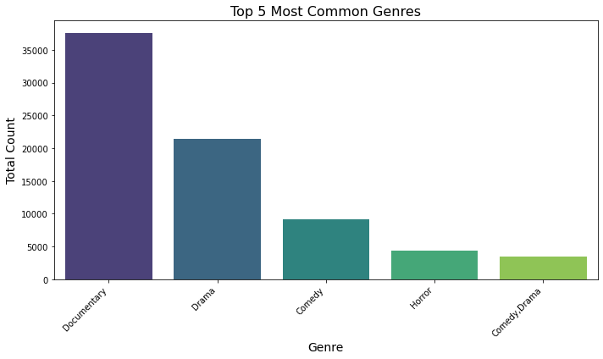
Most Produced Genres
Documentary genre was the most produced genre of movies, followed by Drama, Comedy ,Horror and Comedy Drama during the period.

Slide 10
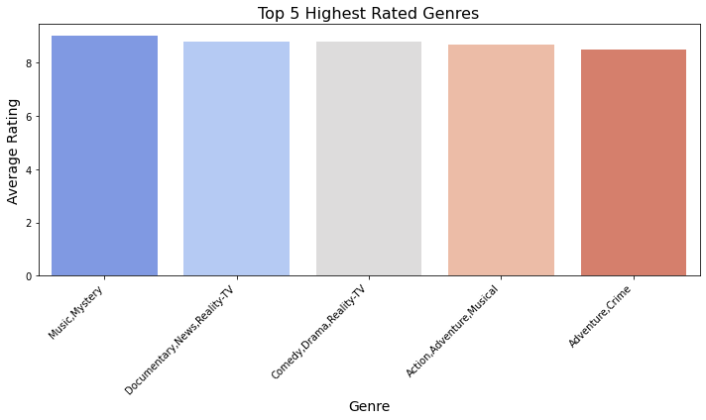
Top Rated Genres
Music, Mystery was the most rated at 9.0, followed by Documentary, News, Reality-TV at 8.8, Comedy, Drama, Reality-TV at 8.8, Action, Adventure, Musical at 8.7 and Adventure, Crime at 8 during the period.

Slide 11
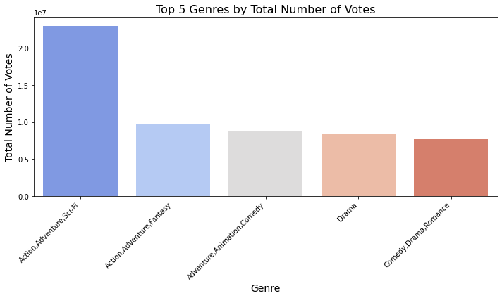
Voting patterns per genre
Action,Adventure,Sci-Fi genre was the highly voted genre with 23,023,248 votes, followed by Action, Adventure, Fantasy genre with 9,658,883 votes.
Adventure, Animation, Comedy genre Drama genre and Comedy, Drama, Romance genre had 8,687,435 votes ,8,395,521votes and 7,665,463votes respectively.

Slide 12
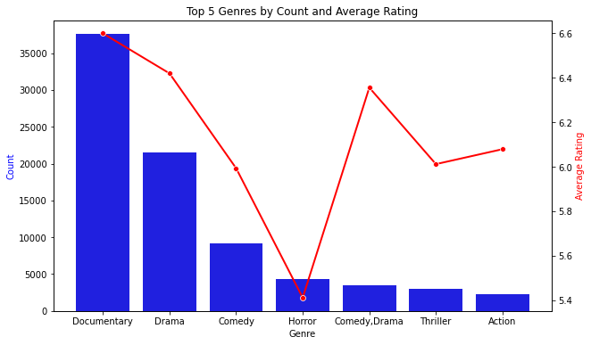
Counts and Average ratings of genres.
The most produced and highly rated genres are: Documentary , Drama and Comedy.
Horror has the lowest average rating among the most produced genres.

Slide 13
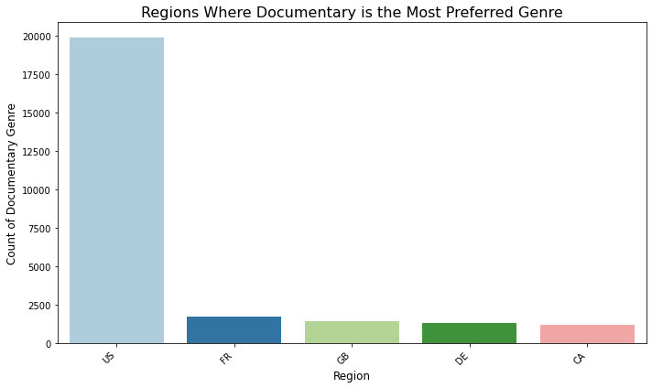
Regional Documentary Preference distribution
The Documentary genre was the most preferred in the US region.

Slide 14
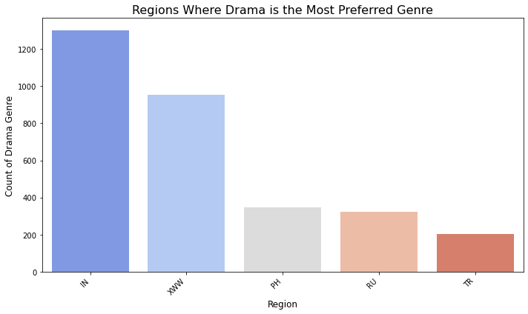
Regional Drama Preference distribution
The Drama genre was the most preferred in the India region.

Slide 15
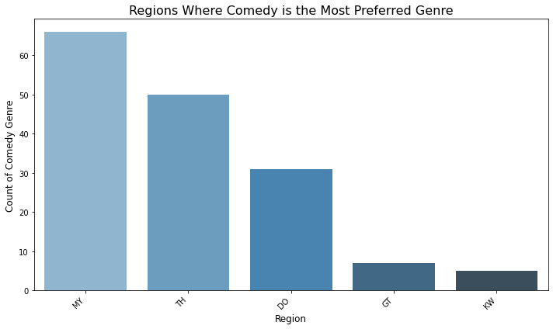
Regional Comedy Preference
The Comedy genre was the most preferred in the Malaysia region compared to Thailand ,DO,GT and KW.

Slide 16
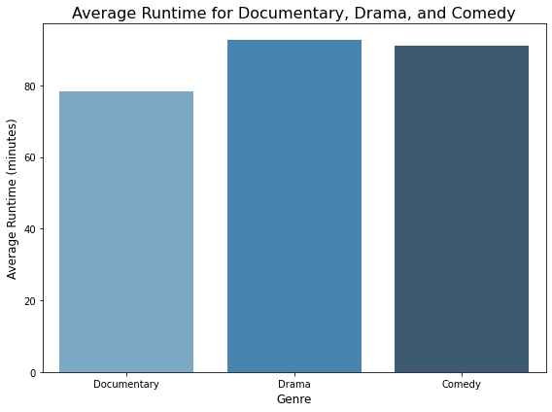
Runtime distribution per selected genre
The average runtime for Documentary is 78 minutes, Drama 98 minutes and Comedy at 91 minutes.

Slide 17
Findings
Documentary is the most preferred genre of movies, followed by Drama, Comedy ,Horror and Comedy Drama.
Music, Mystery is the highly rated genre at 9.0, followed by Documentary, News, Reality-TV genre at 8.8, Comedy, Drama, Reality-TV genre at 8.8, Action, Adventure, Musical genre at 8.7 and Adventure, Crime genre at 8.
Action,Adventure,Sci-Fi genre was the highly voted genre with 23,023,248 votes, followed by Action, Adventure, Fantasy genre with 9,658,883 votes. Adventure, Animation, Comedy genre Drama genre and Comedy, Drama, Romance genre had 8,687,435 votes ,8,395,521votes and 7,665,463votes respectively.

Slide 18
Findings Cont’d
Documentary is the most preferred genre in US, while Drama is preferred in India, XWW, PH and Russia in that order.
Comedy is mostly preferred in Malaysia, TH,DO in that order respectively.
The average runtime for Documentary is 78 minutes, Drama 98 minutes and Comedy at 91 minutes.

Slide 19
Recommendation
1. The studio should focus on genres that have High average rating and are most preferred .i.e Documentary, Dramas and Comedy. And the studio should also focus on producing high quality documentaries and drama in order to increase the genres’ average rating to match genres that are highly rated .i.e. music and mystery genre that has an average rating of 9.
2. The studio should adjust the length of the movie to align with audience expectations and preferences. Drama should maintain around 98 minutes of runtime and comedy approximately 91 minutes to balance humor and narrative flow.
3.The studio should observe regional preferences of the genres. By Creating and modifying content to fit the specific preferences and culture:
Documentary genre to focus on the US region, Drama genre to focus on the India region and Comedy genre to focus on the Malaysia region.

Slide 20
Conclusion
The company should go ahead and set up the studio which would focus on the following three genres namely: doc, drama & comedy whiles focusing on the recommended regions per genre.
Further analysis of the set up and production costs of the genres and the expected income is required.

